Slide 1

Movie-Data Exploratory Analysis
By Saurabh Agrawal (August 2020 Cohort)
Email : saurabh9486@gmail.com

Slide 2
Id | Feature | Description
01 | Rank | Movie Rank
02 | Title | Title of the movie
03 | Genre | The various Genre that the movie can be associated with
04 | Description | Short description about the movie
05 | Director | Director of the movie
06 | Actors | Main actors in the movie
07 | Year | Year in which the movie was released
08 | Runtime (minutes) | Total movie playing time
09 | Rating | Movie rating
10 | Votes | Vores for the movie
11 | Revenue (Millions) | Revenue by the movie (in millions)
12 | Metascore | Is the score of the movie on the metacritic website by critics

Slide 3

Data Processing

Slide 4
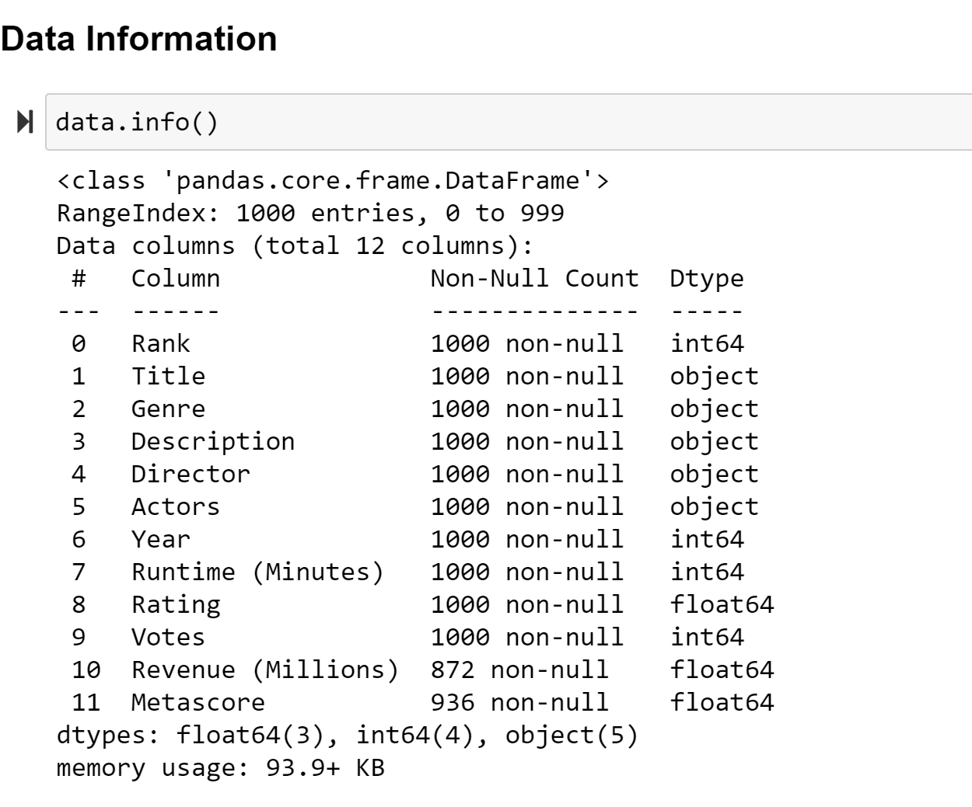
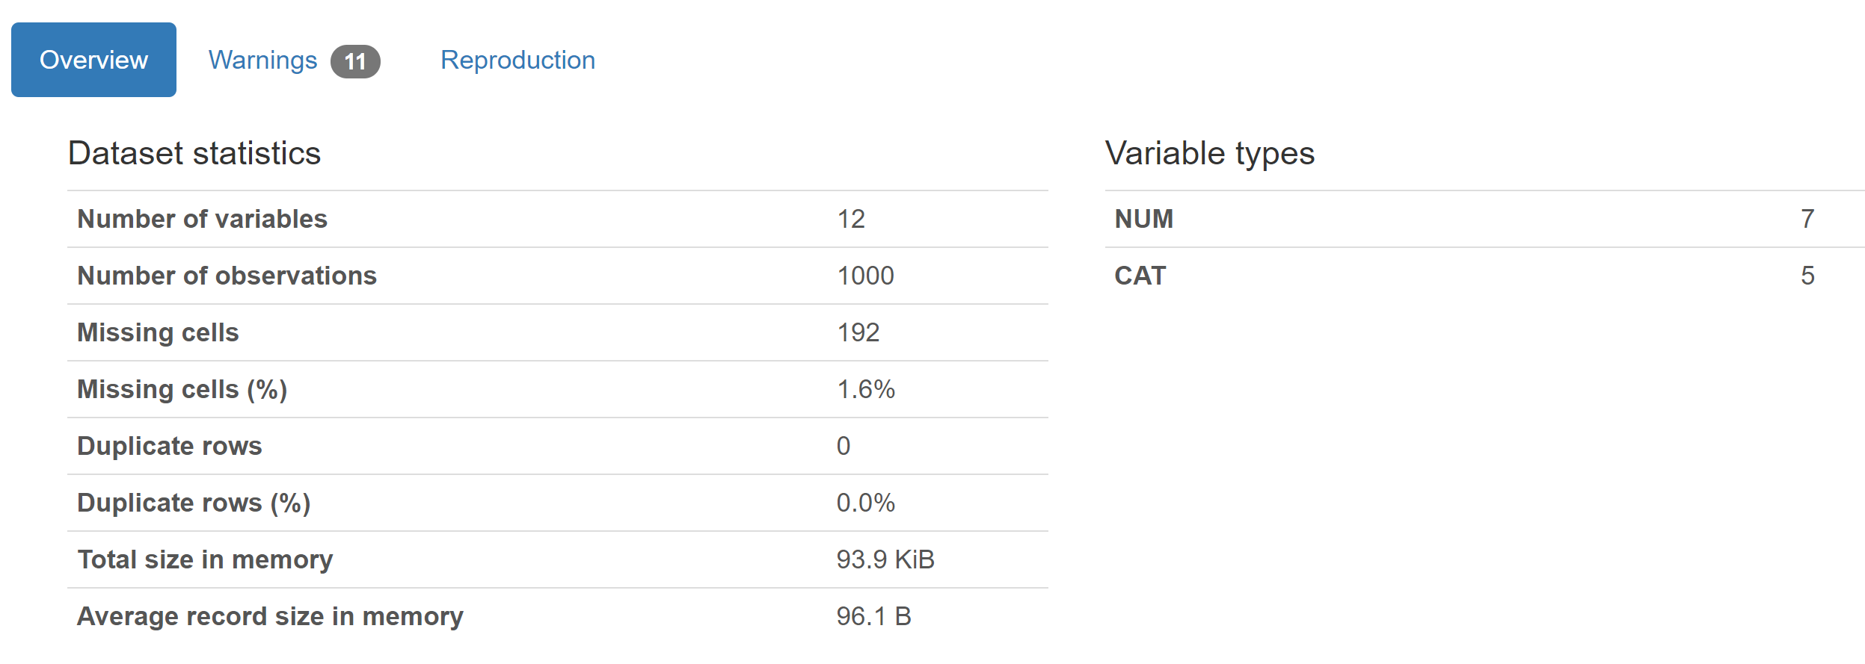

Slide 5
Missing Values

Slide 6
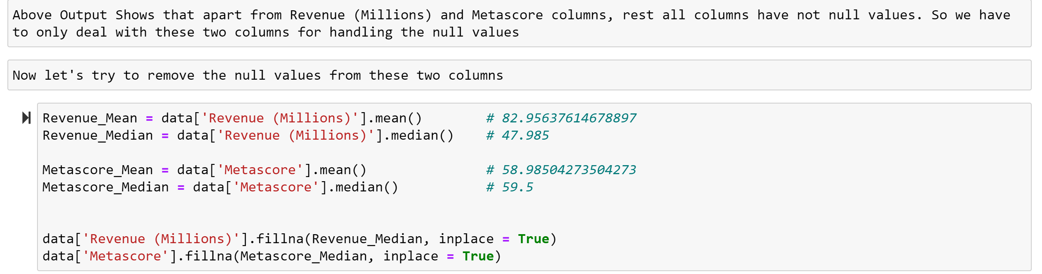
Replaced Missing values with the Median values of that respective feature

Slide 7

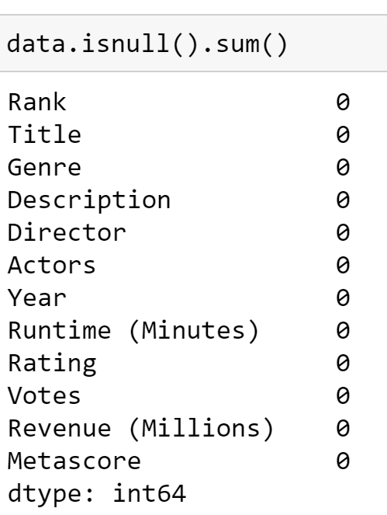
After Data Cleaning, All Null elements are removed

Slide 8
Feature Engineering

Slide 9
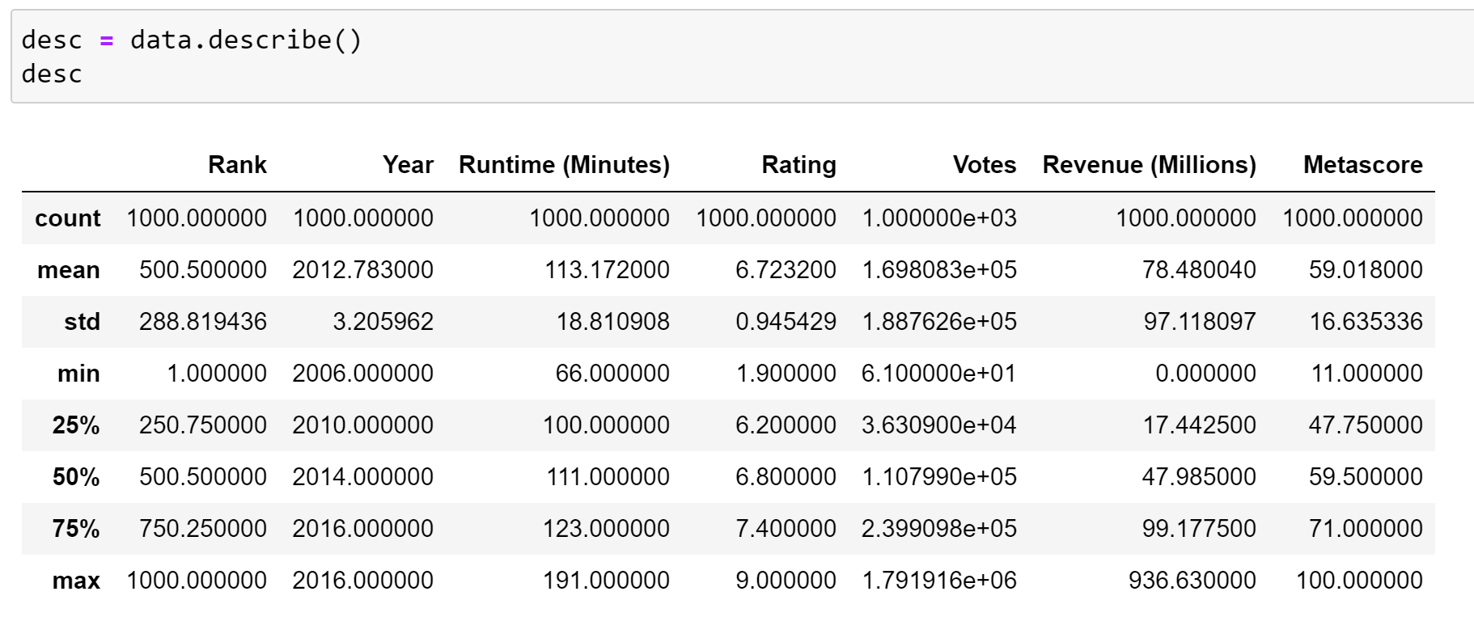

Slide 10
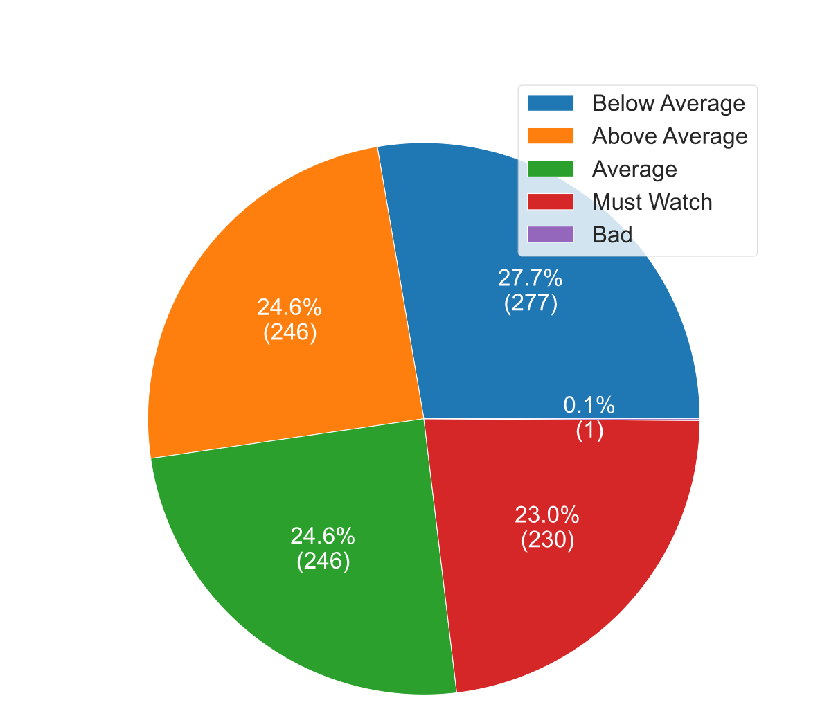
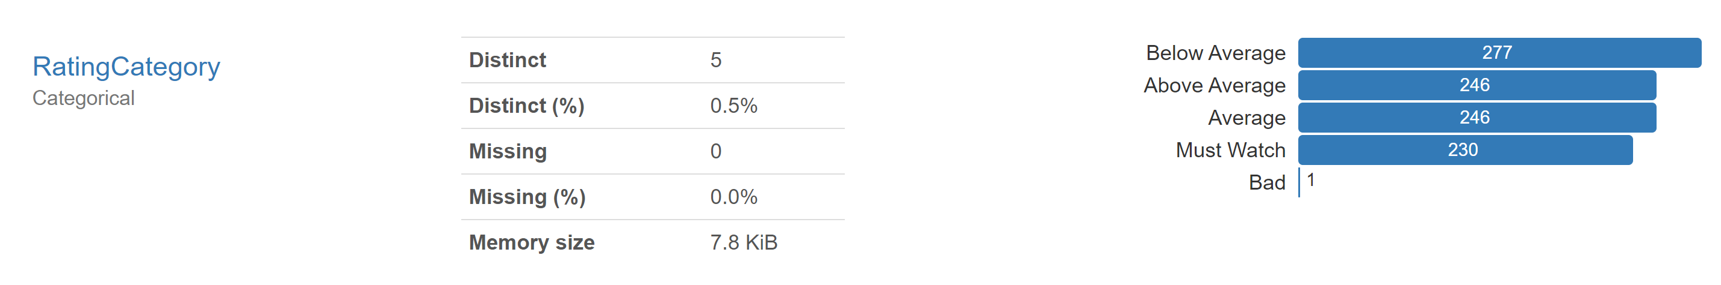
Added New Feature : RatingCategory

Slide 11
Exploratory Data Analysis

Slide 12
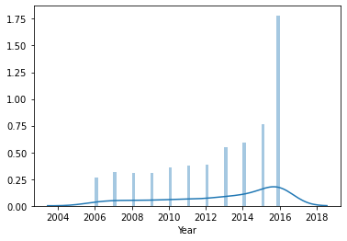
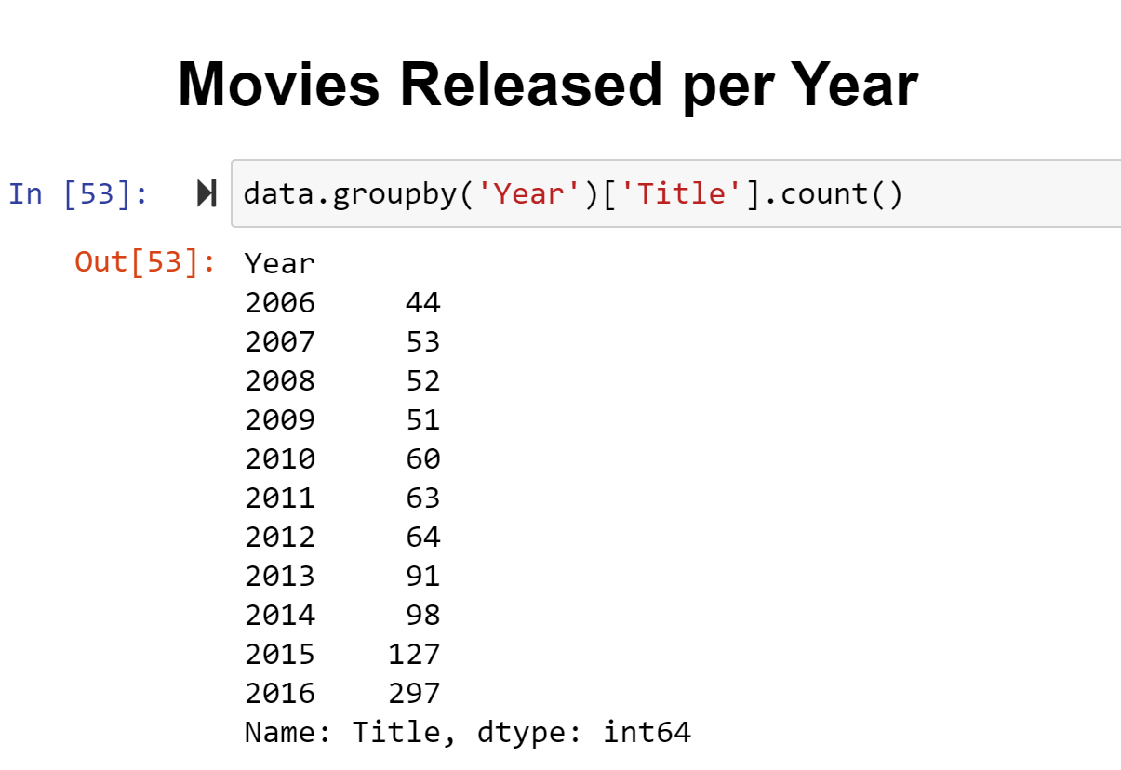
Movies Released per Year

Slide 13
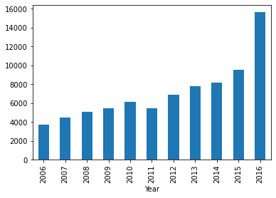
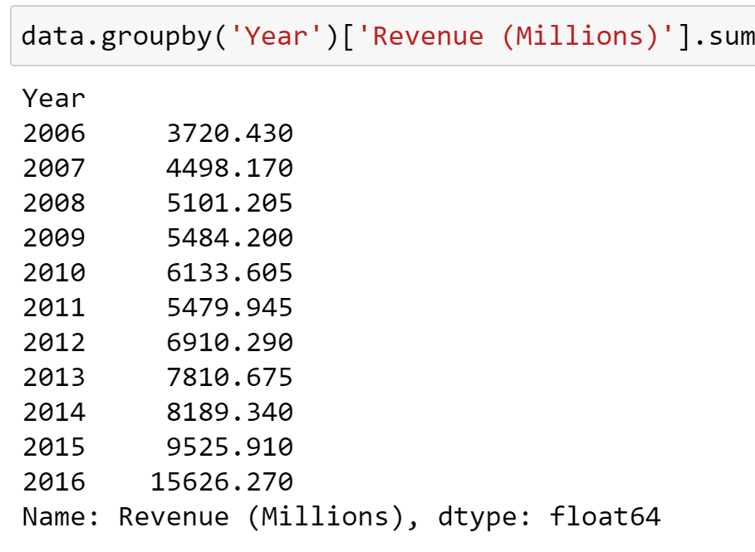
Revenues per year

Slide 14
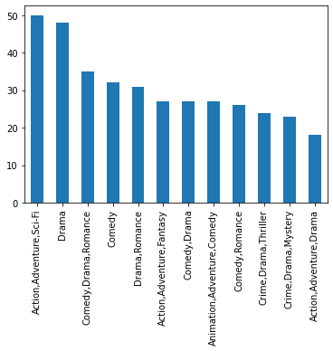
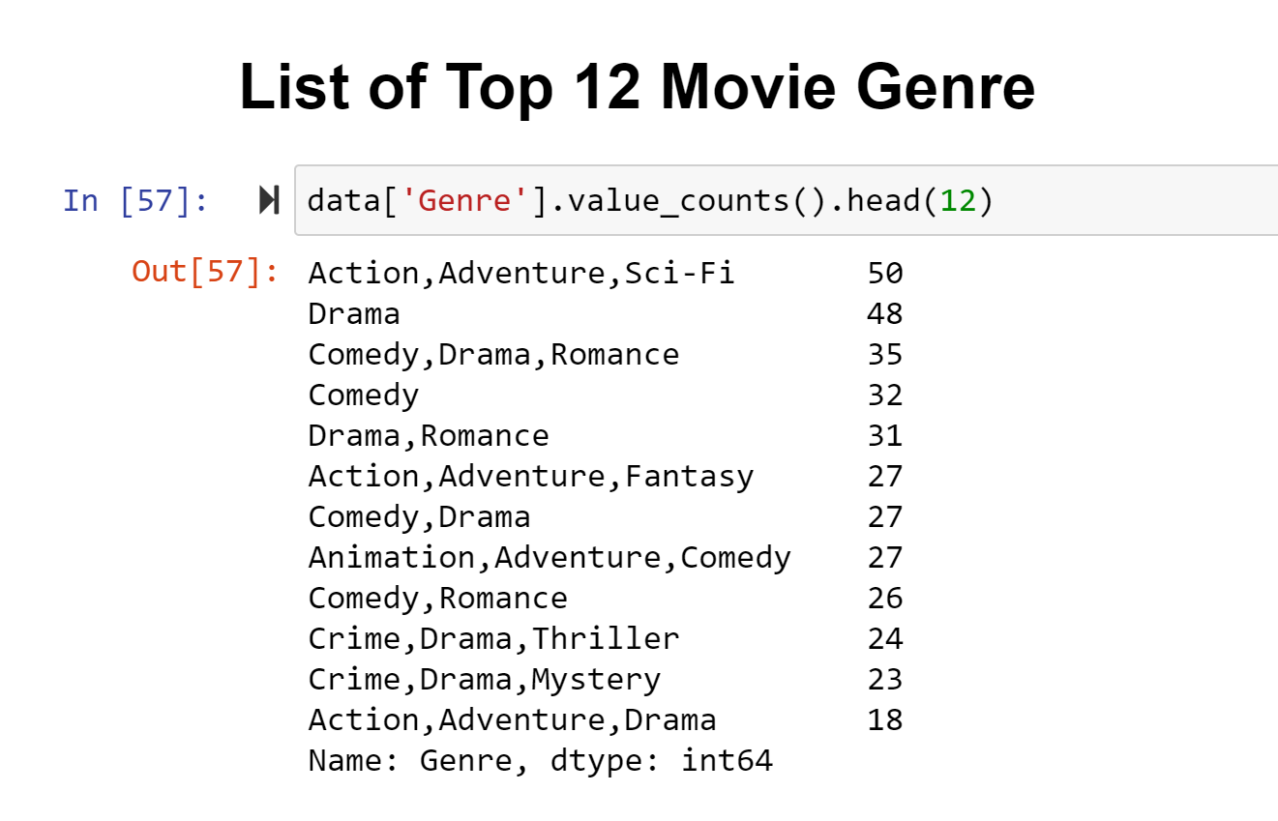

Slide 15
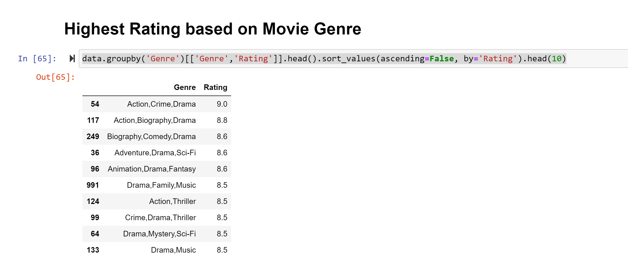

Slide 16
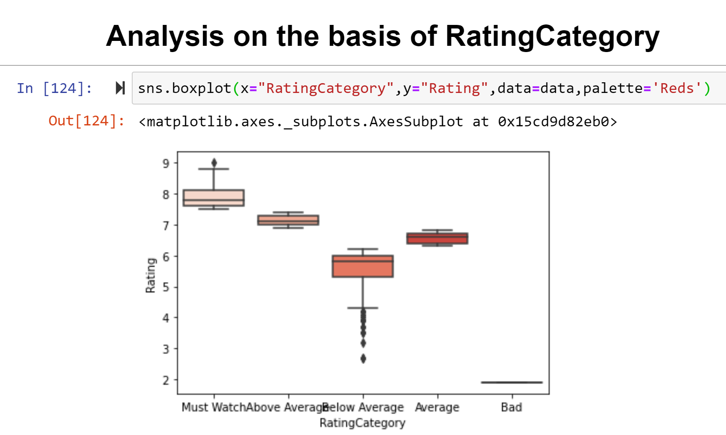

Slide 17
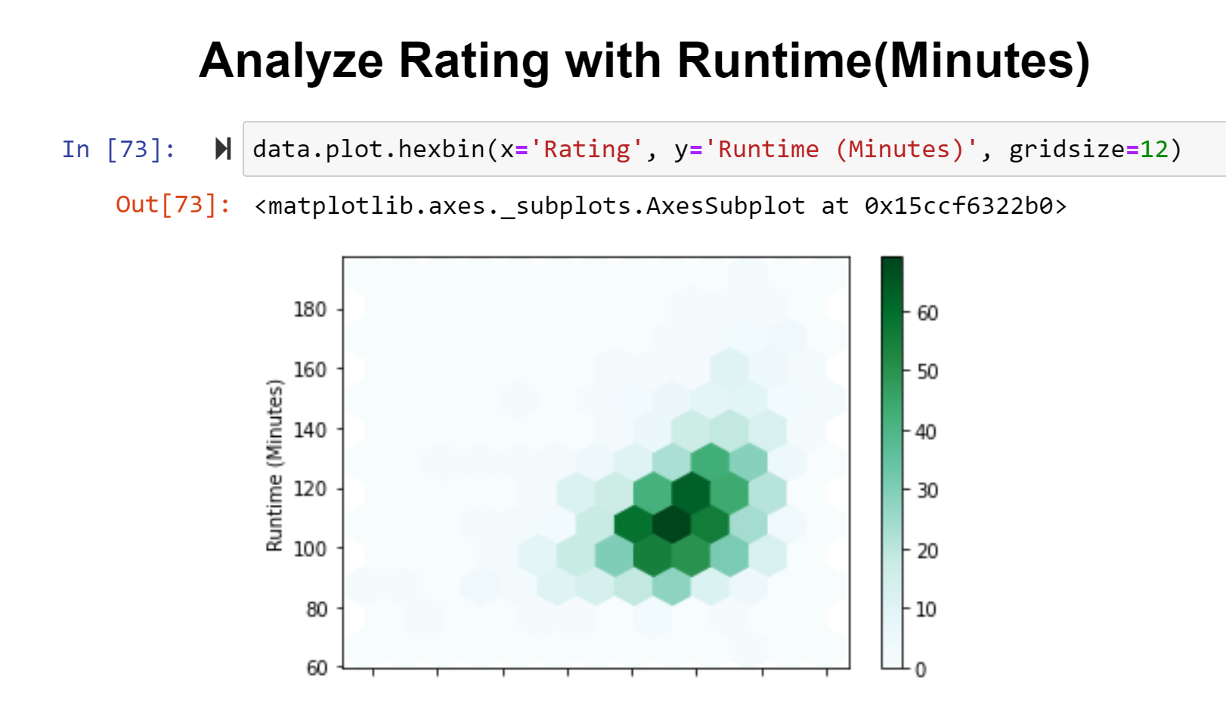

Slide 18
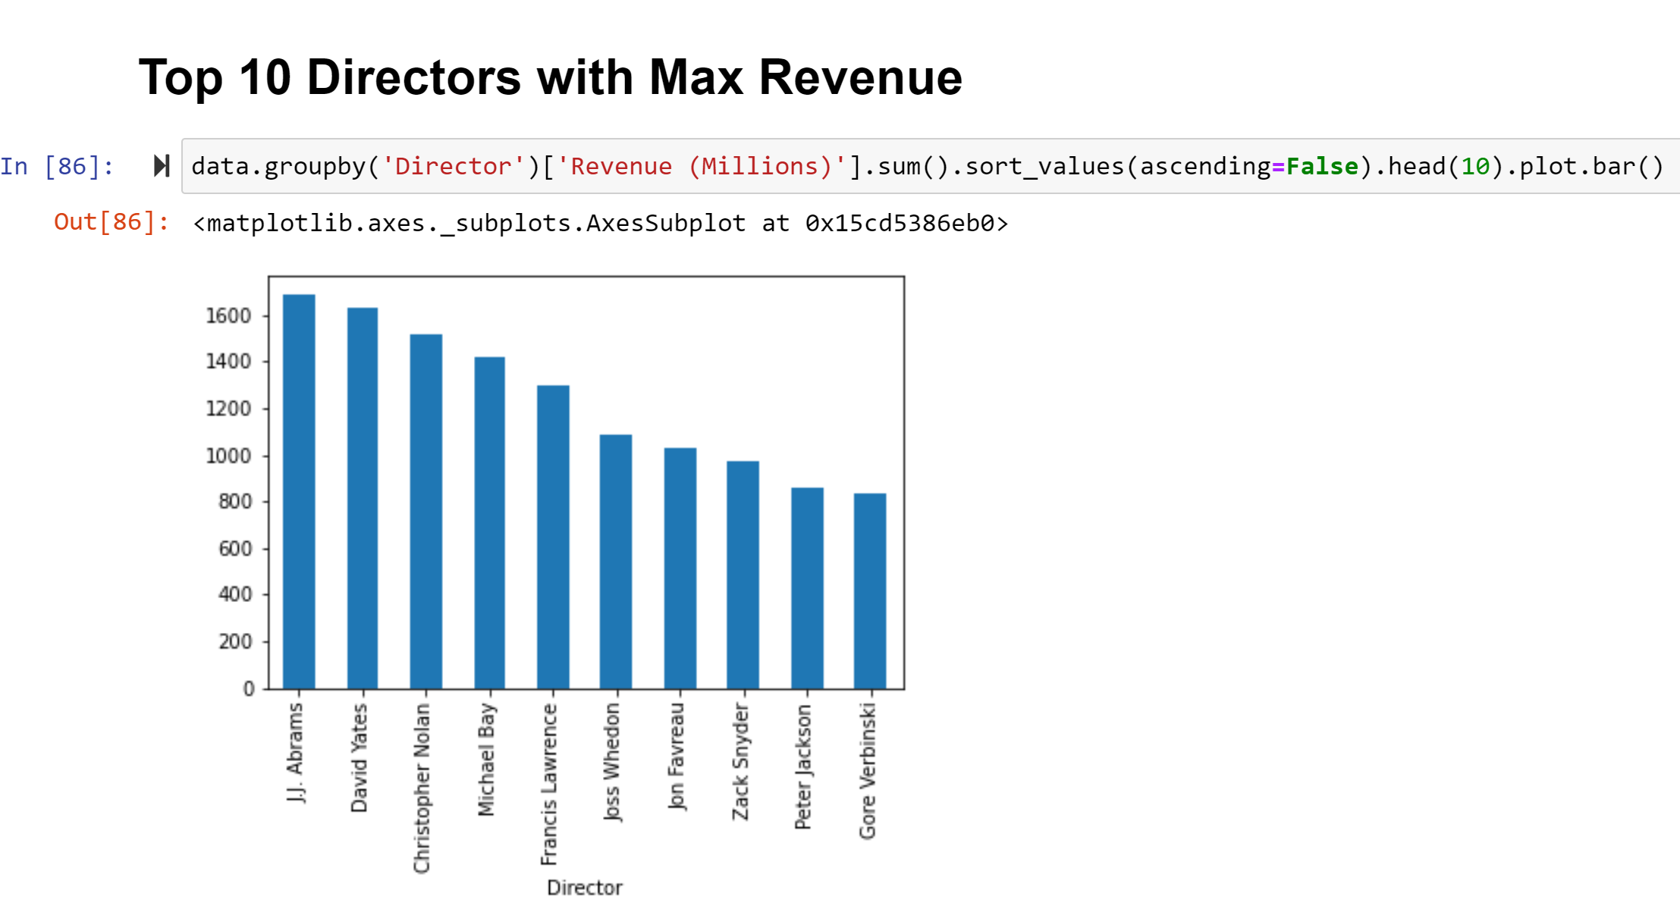

Slide 19
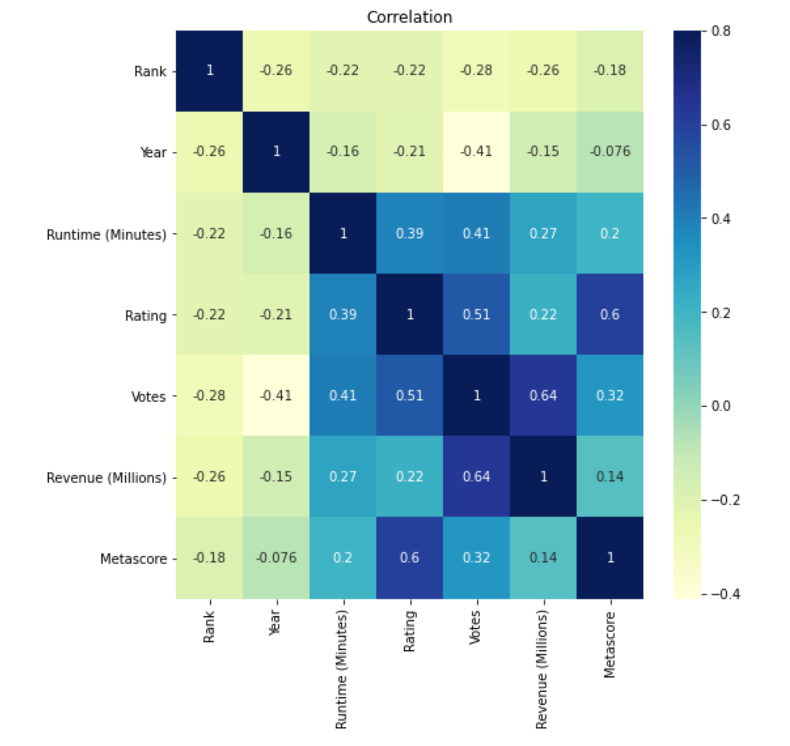

Slide 20

Summary of Movie-Data Analysis
a) This Movie Data contains 1000 rows and 12 columns.
b) The Data had very less missing values and that too in Revenue and Metadata feature only.
c) Pre and Post Profiling has been done using the panda profiling.
d) Most of the movies released in 2013, 2014, 2015, and 2016.
e) Maximum number of movies were released in year 2016.
f) Most successful year in terms of revenue was year 2016.
g) Action,Adventure,Sci-Fi is the most revenue geenerating Movie genre.
h) Rating Categorized as 'Bad' , 'Below Average', 'Average', 'Above Average', 'Must Watch', which can give more insight.
i) Rating of Movie is highly corelated with Votes and Metascores of the movie.
j) Revenue of the Movie is highly corelated to the number of votes to the movie.
Thank you

